Slide 1

EMPLOYEE
WELLNESS
ANALYTICS
Data Cleaning • Data Modeling • Dashboard Development
Notes:
Introduce the project: Employee Wellness Analytics built entirely in Microsoft Power BI Desktop, covering data preparation, star schema modeling, and interactive reporting.

Slide 2
EXECUTIVE SUMMARY
Project Overview
Transforming raw employee wellness records into an interactive Power BI analytical model to track engagement and health outcomes.
Source Data
Data Cleaning
Data Model
Power BI Report
Wellness Analysis
Raw CSV exports tracking employee profiles and wellness activity logs.
Power Query cleans, standardizes types, and creates analytical flags.
Star schema linking facts to dimensions, with a DAX Date table.
Two-page dashboard featuring slicers, drill-down, and trend visuals.
Targeted insights across departments, designations, and goals.
Core Objective
Tooling Stack
Analyze employee participation, activity completion rates, and wellness scores across departments.
Microsoft Power BI Desktop, Power Query M engine, and DAX modeling for date intelligence.
Notes:
Walk through the project lifecycle: ingestion of CSVs, Power Query transformations, DAX date modeling, and deployment of executive dashboards.

Slide 3
SCHEMA ARCHITECTURE
Data Sources & Dataset Structure
The analytical model integrates three primary tables connected through standardized primary and foreign keys.
DIMENSION
FACT TABLE
DAX DIMENSION
Employee_Wellness_Profile
Wellness_Activities
Date
Transactional logs capturing wellness participation events.
Common time intelligence dimension generated dynamically via DAX.
Granular demographic & organizational attributes per employee.
Activity ID & Employee ID
Activity Date
Duration (Minutes)
Participation Status
Wellness Points
Date (Date Key)
Year
Quarter
Month & Month Name
Day of Week
Employee ID (Primary Key)
Department & Designation
Wellness Goal
Activity Level
Wellness Score
Notes:
Explain the three core tables: Employee Profile dimension, Wellness Activities fact table, and the dedicated DAX Date dimension, emphasizing key joins.

Slide 4
Data Cleaning & Transformation
Get Data → Text/CSV → Transform Data
Promote headers and apply data types
Trim and Clean text; standardize categories and email casing
Convert dates using locale settings and fix inconsistent durations
Preserve missing values as null where data is not recorded
Add Completed Flag and Calories Recorded Flag
Run duplicate, missing Employee ID and key-consistency checks
Cancelled records remain available for cancellation analysis.
“20 mins” is converted to numeric duration.

Slide 5
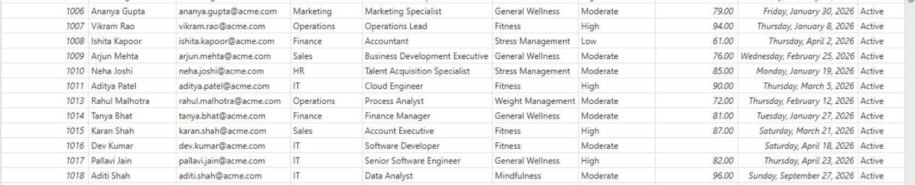
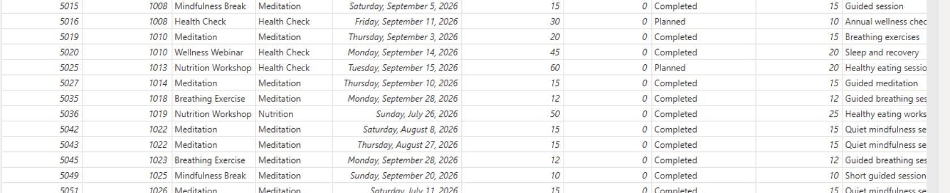
TRANSFORMATION EVIDENCE
From Raw Data to Analysis-Ready Dataset
Side-by-side comparison of the cleaned fact and dimension tables ready for reporting.
Cleaned Dimension: Employee_Wellness_Profile
Cleaned Fact: Wellness_Activities
Profile Dimension: Standardized department, designation, and wellness score attributes keyed on unique Employee ID.
Activities Fact: Standardized numeric durations, explicit Completed Flag, and preserved null values for unrecorded calories.
Notes:
Review the transformed tables in Power BI Desktop: the employee profile dimension on the left, and the normalized wellness activities fact table on the right.

Slide 6
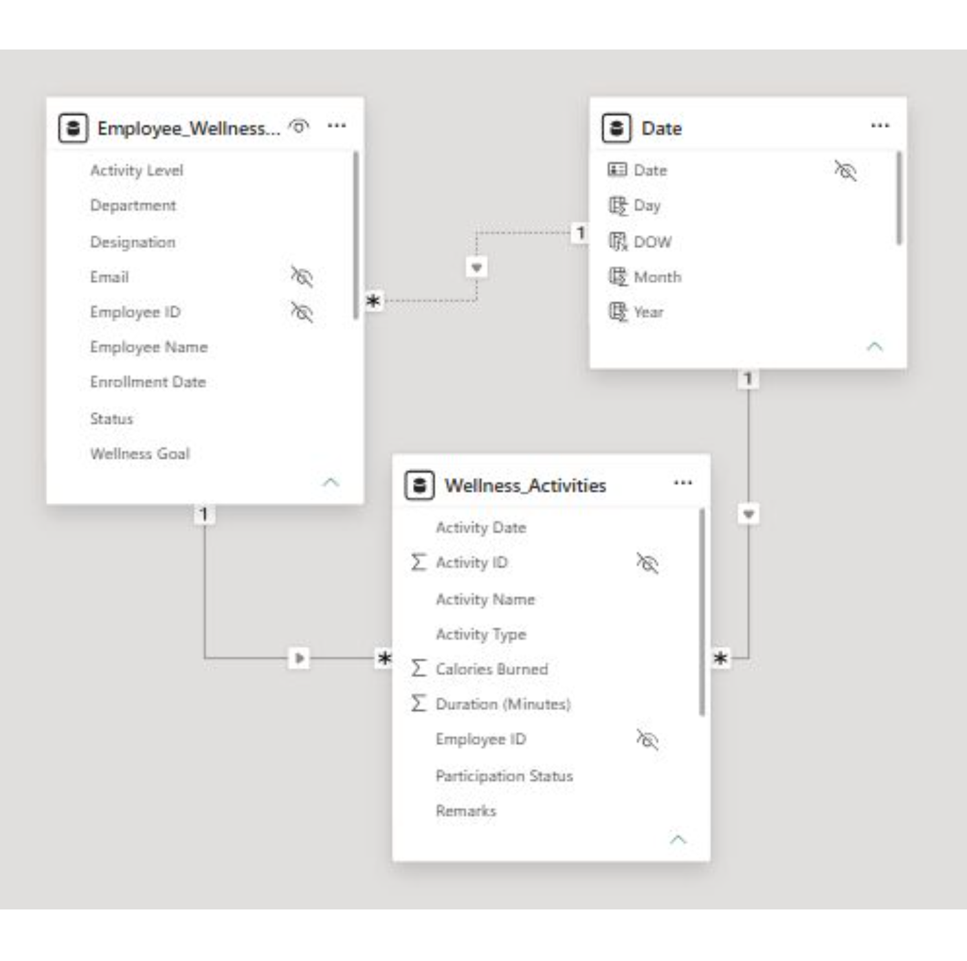
DATA ARCHITECTURE
Data Model & Relationships
A simple STAR SCHEMA with Wellness_Activities at the centre, filtered by Employee_Wellness_Profile and Date dimensions.
Relationship | Cardinality & filter
Employee_Wellness_Profile[Employee ID] → Wellness_Activities[Employee ID] | One-to-Many, Single, ACTIVE
Date[Date] → Wellness_Activities[Activity Date] | One-to-Many, Single, ACTIVE
Date[Date] → Employee_Wellness_Profile[Enrollment Date] | One-to-Many, Single, INACTIVE; enrollment analysis uses USERELATIONSHIP
Hierarchy: Department → Designation supports dashboard drill-down.
Notes:
Highlight the star schema structure, active filtering paths, and how the inactive relationship on Enrollment Date is invoked using DAX USERELATIONSHIP.

Slide 7
DASHBOARD NAVIGATION
Power BI Report Structure
The interactive Power BI report is structured into two dedicated analytical views.
PAGE 1
PAGE 2
Overview Dashboard
Wellness Analysis
Macro-level health metrics, executive KPIs, and longitudinal monthly participation trends.
Deep diagnostic exploration across organizational hierarchies, activity tiers, and personal goals.
Visual Inventory
Visual Inventory
Month slicer for temporal filtering
Average Wellness Score by Department
Average Activity Duration by Activity Type
Monthly Duration & Wellness Points trend
Department → Designation hierarchy slicer
Average Wellness Score vs Average Activity Duration by Department Scatter Chart
Wellness Score by Activity Level
Wellness Score by Department & Wellness Goal
Notes:
Present the dual-page report structure: Page 1 provides high-level executive tracking while Page 2 facilitates departmental and behavioral drill-downs.

Slide 8
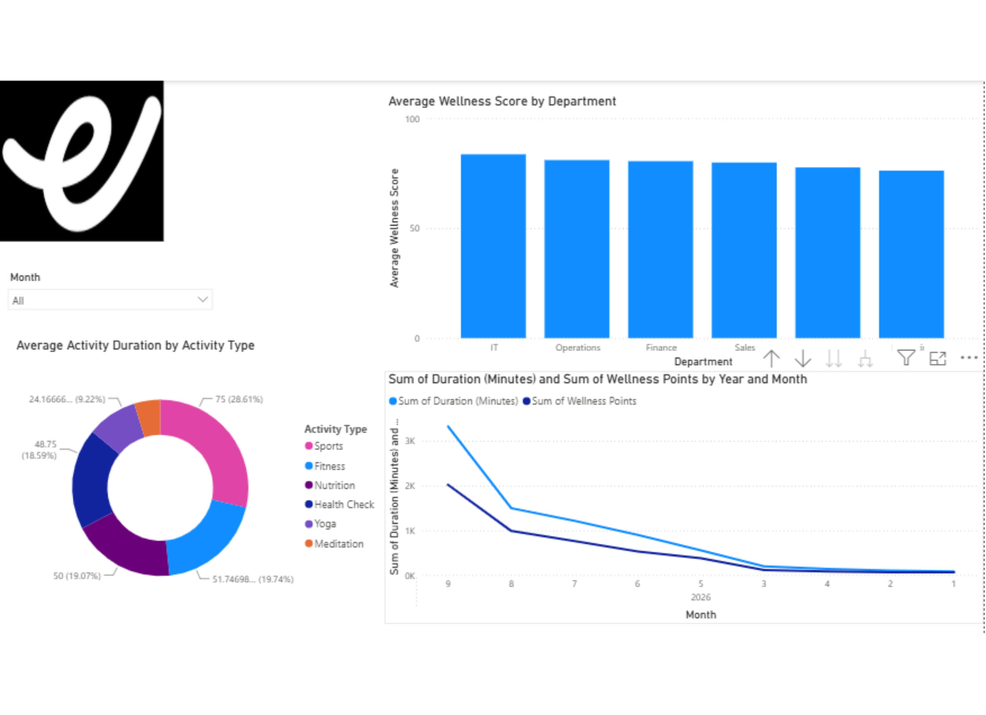
Power BI Report — Page 1: Overview
Month slicer
Average Wellness Score by Department
Average Activity Duration by Activity Type
Monthly Duration & Wellness Points
This page provides a high-level view of employee wellness scores, activity duration and monthly wellness trends.
Notes:
This page provides a high-level view of employee wellness scores, activity duration and monthly wellness trends.

Slide 9
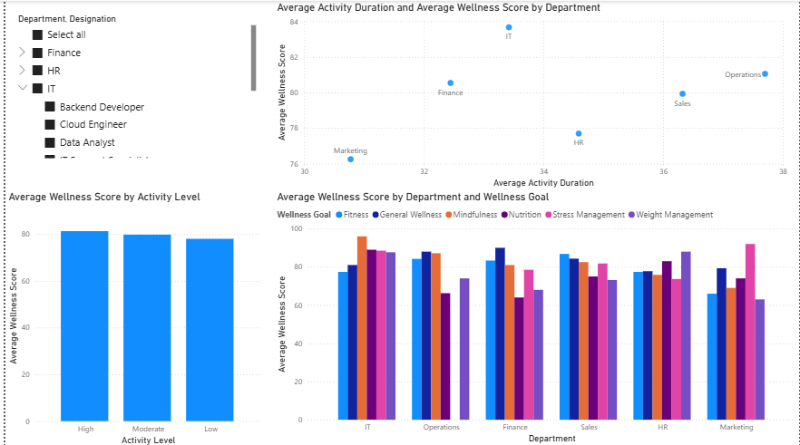
PAGE 2 VISUAL REPORT
Power BI Report — Page 2: Wellness Analysis
Department → Designation hierarchy
Average Wellness Score by Activity Level
Average Wellness Score by Department and Wellness Goal
Notes:
Present Page 2 deep-dive analytics: highlight the key benchmark metric of 79.93 Average Wellness Score and demonstrate drill-downs into designations and wellness goals.

Slide 10
IMPACT & DELIVERABLES
Project Outcome
The project transforms raw employee wellness data into an interactive Power BI analytical model and dashboard for exploring participation, wellness and employee engagement.
Wellness participation
Completed vs planned activities
Wellness points
Activity types and duration
Calories recorded
Monthly trends
Department-level participation
Overall employee engagement
Notes:
Conclude the presentation by summarizing the overall project deliverables, the dual-dashboard reporting system, and the ongoing value for HR and leadership decision-making.

